Slide 1
Compression Program Part 3
Mohammed Imran

Slide 2
Task 3
Develop a program that builds upon the technique from Task 2 to compress a text file with several sentences, including punctuation. The program should be able to compress a file into an array of words and array of positions to recreate the original file. It should be able to take a compressed file and recreate the full text, including punctuation and capitalisation, of the original file.
Analyse the requirements for this system and design, develop, test and evaluate a program to compress a text file and reproduce the original text from a compressed file. You will need to create a text file with more than one sentence to test your system.

Slide 3
Analysis
Task 3 asks me to use both element from both task 1 and task 2. In this task the main focus is compression and decompression. The program should be able to input from the user and compress the list of positions (giving the same words the same positions) like in task 2. The main difference is that I will need to decompress the positions which means recreating the sentence from the positions. In addition to this I will include punctuation and capitalization using the compressed file. For this to be more practical I decided to make two separate programs to create this.

Slide 4
Success Criteria
The code is successful when:
The program should work efficiently with no logical or syntax errors
The program should identify individual words in the sentence
The program should store the positions into an array
The program should label the same words with the same positions
The program should store the word inputted as a variable
The sentence should have punctuation
The program should be case sensitive so “ ask, Ask ASK” is not the same word
The program should save the positions and unique words into a file
The second program should recreate the sentence from using the variables
The second program should import variables from text file

Slide 5
Validation
A form a validation in task 3 is when adding the unique words into the variable uniqueword, using the if statement it makes sure that the same words are not added again. The program allows case sensitivity by giving different positions to capitalisation, this is done as well as being a task, it also allows the sentence to be created with capitalisation. It also does allow punctuation to also completely recreate the sentence.
If I had more time I would validation I could use a form of length check, this will allow the program to only accept conventional sentence lengths and not paragraph. What I also could do is add a presence check to the program, this will make sure the user inputs something into the program and not leave it blank. A further validation type I could use is a spell check, to alert the user of incorrect spelling when the input into the program.

Slide 6
Programming Techniques
I will be using the variable function allows me to store text or data. This can be used to store the users input which is essential for the program to work. The “.split” function separates words in a sentence, the separating of the words allows the program to put the words in an array. The if statement and asks the program a true or false question. The append function adds text or data into a variable, in the program I used this to add the positions into an array. The .index() searches for data you ask in a variable. The .read() function reads files opened in the program, combined this with variables allow me to store data from files into a variable in the program. The file.write function allows my to write into files I have created, this is useful to put in the array of positions into a text file. The print function is used to print out information from the program this is useful when testing if variable work correctly. The .truncate() function clears already existing data in an opened file, this is useful so when the program is used multiple times the program will remove data previously created.

Slide 7
Algorithm
Input (“enter a sentence”)
Store unique words into a variable
Locate positions
Put these positions into a list
Export list into a file
Export Unique words into a file
SECOND PROGRAM
Import List
Import Unique words
Use lists and unique words to recreate sentence

Slide 8
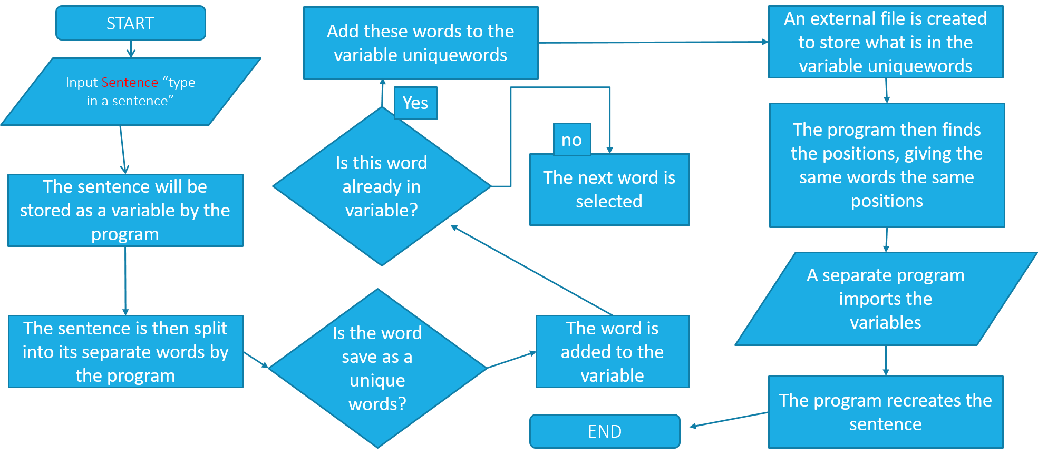
Flow Chart

Slide 9
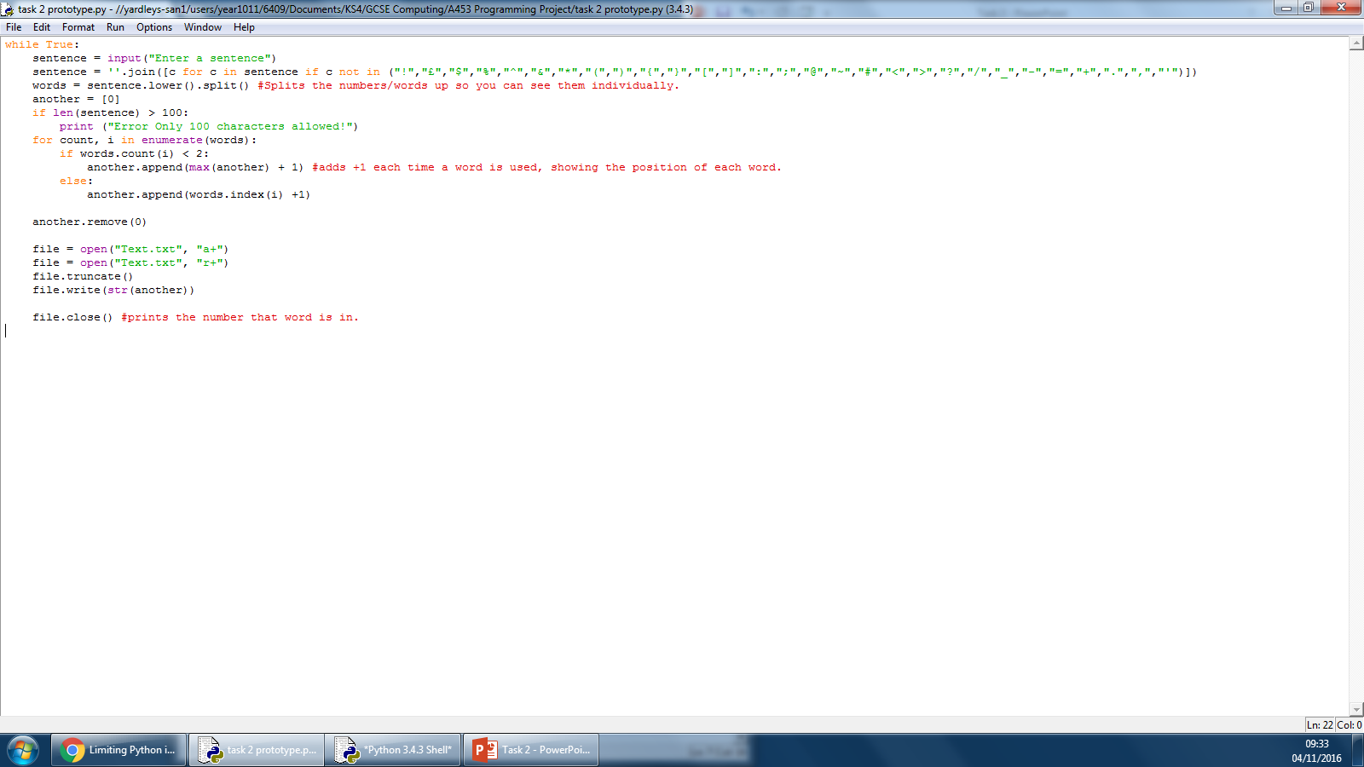
Development (Inputs)
The variable sentence stores whatever the user inputs
The input function allows the user to input anything and will be stored into a variable

Slide 10
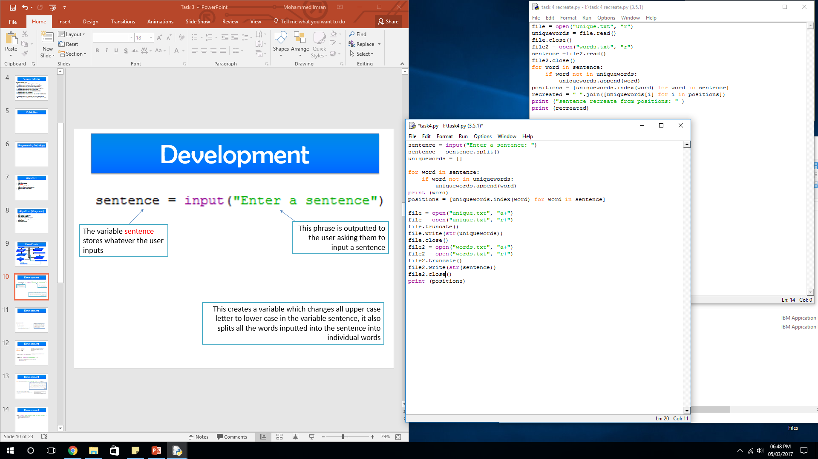
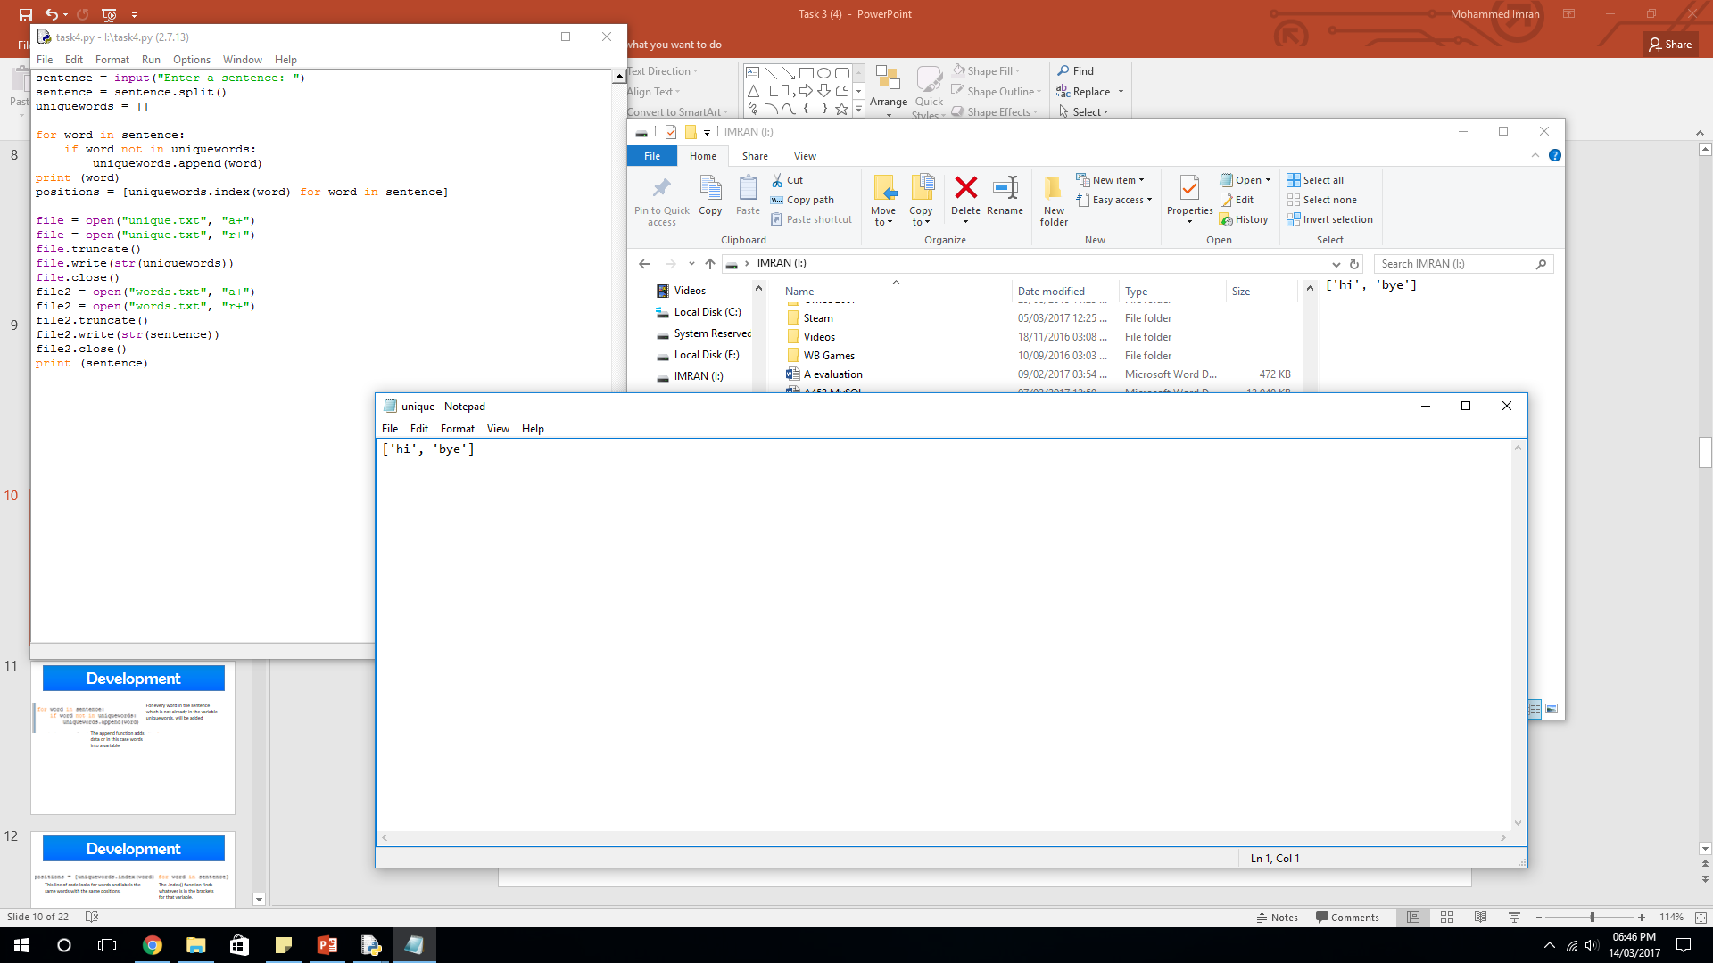
Development (Operators)
This operator modifies the already existing variable sentence and splits the words in the variable into individual words, this makes me able to assign a position for each word from the variable sentence
To find out what the .split function does I printed the variable sentence into the program

Slide 11
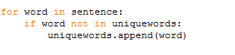
Development (List Creation)
This line of code tells the program that for every word in the sentence which is not already in the variable uniquewords, will be added
The if statement asks a question and acts upon it. In this case if the word is already added to the unique words variable it will not add it
The append function adds data or in this case, words into a variable. So information can be added, because of the if statement it does not add the same time.

Slide 12

Development (List Manipulation)
This line of code looks for words and labels the same words with the same positions.
Labels every word in the sentence
The .index() function finds whatever is in the brackets for that variable. So once all words are given a position it will not label it again.

Slide 13
Development (File Creation)
The file.truncate clears opened files
This creates two files one readable and one append-able (can be modified). The 3rd line of code then truncates the files which means removing any already existing content from the file. The 4th line of code then inputs this data into a file
The file.write function allows the user to write into the file opened.
This does the same as the previous section but saving different text to a different file.

Slide 14
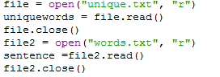
Development (Importing File To Program 2)
Being a separate program I will need to import the text from the files. This code turns the text in the file into variables.
The first line of code opens the file “unique.txt” from the computer system files.
The second line of code reads that file in the program, it then stores what it read from the file into a variable. The rest of the code repeats the previous step for a different file.
The file.read function reads whatever is in the text file. I then put that text into a variable.

Slide 15
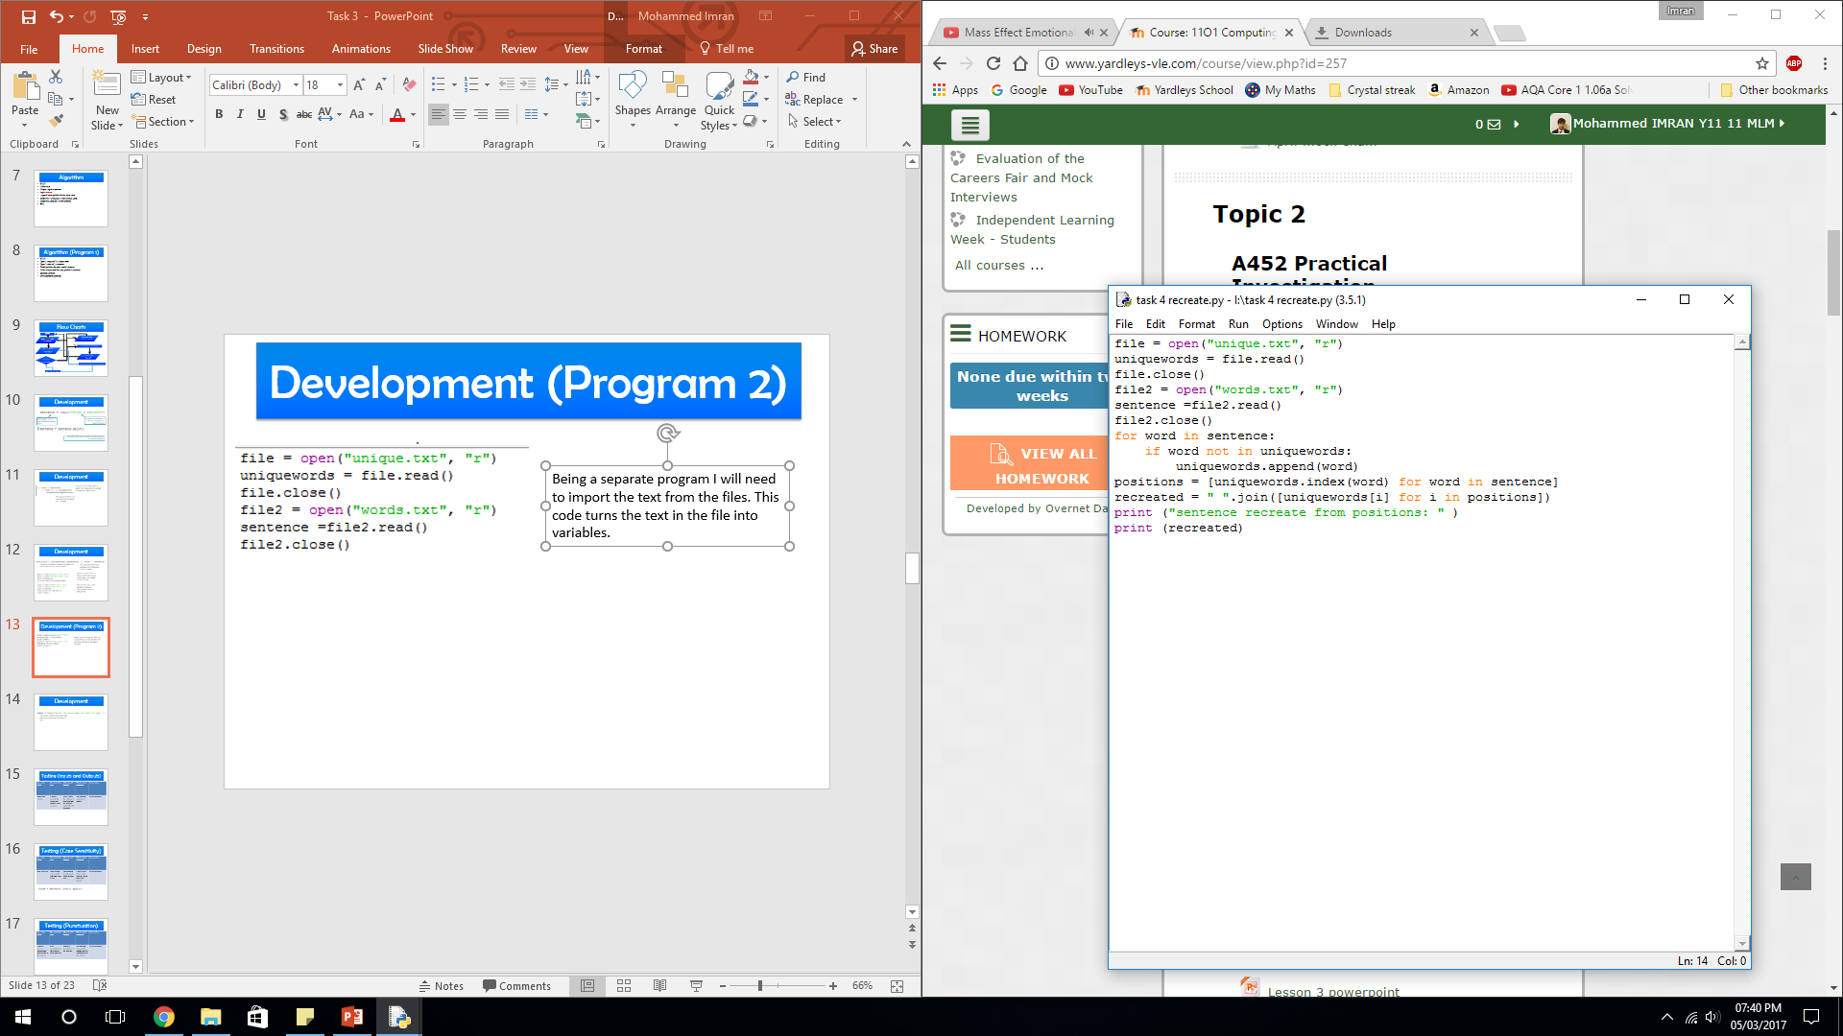
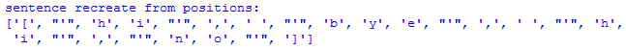
Development (Recreation Of Sentence)
This uses the variable imported from the previous program and uses the positions to recreate the sentence.
The .join function is used to make sure that the words are split and not the letter. If the .join function is removed it splits every single character in the sentence including spaces. (seen in the screenshot)

Slide 16
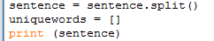
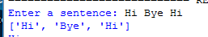
Development (Case Sensitivity)
Area to be tested | How to test this area | What should happen | What actually happened | Action taken
In this area I am going to test if the program detects words with different capitalisation as the same or not | Input a sentence with capitalisation and use the print function to see what outputs | The program should output the words split up but keep the capitalisation unlike the previous tasks | The program worked as it should. | No action taken

Slide 17
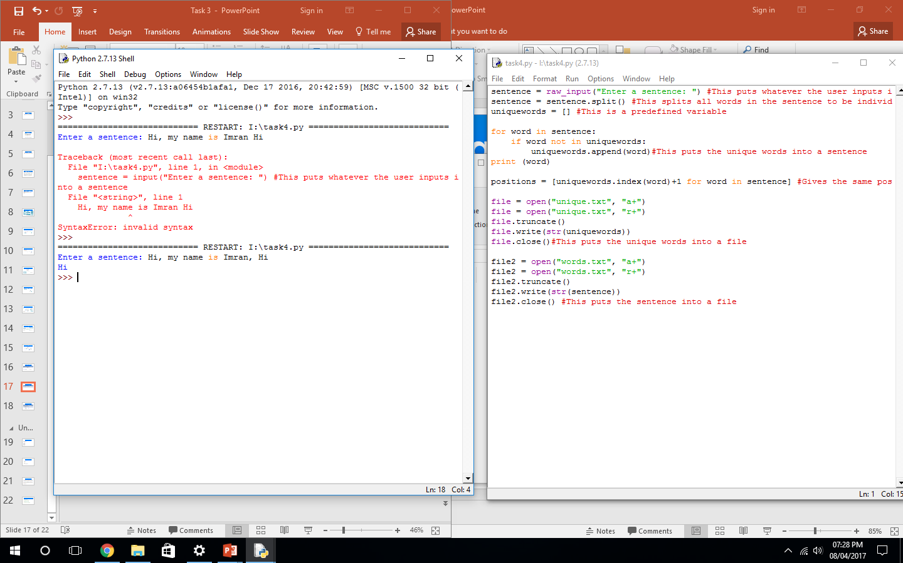
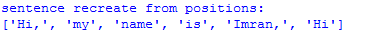
Development (Punctuation)
Area to be tested | How to test this area | What should happen | What actually happened | Action taken
This area of testing I am testing if the program gives different positions to words with punctuation to words without punctuation. | Add punctuation to the sentence when inputted and print the sentence variable in the RTE. | The program should recreate the sentence and print it to the user. | The program did detect the punctuation as different positions | No action taken.

Slide 18
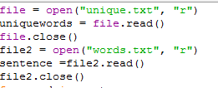
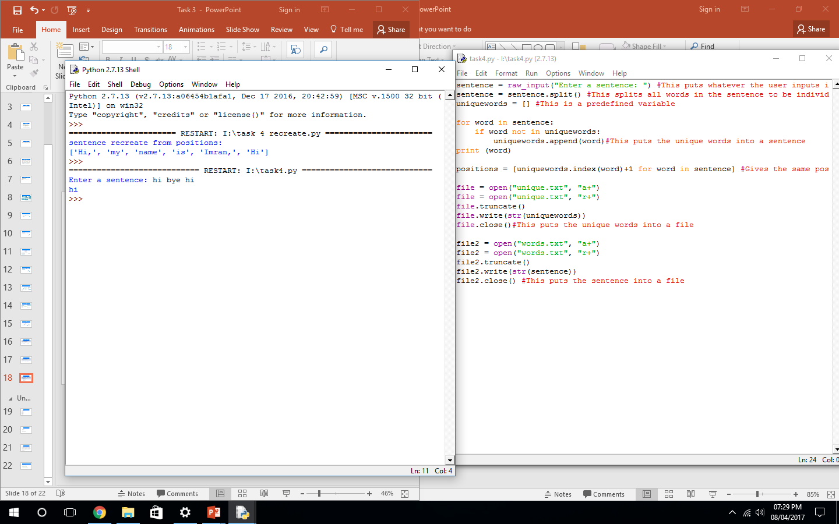
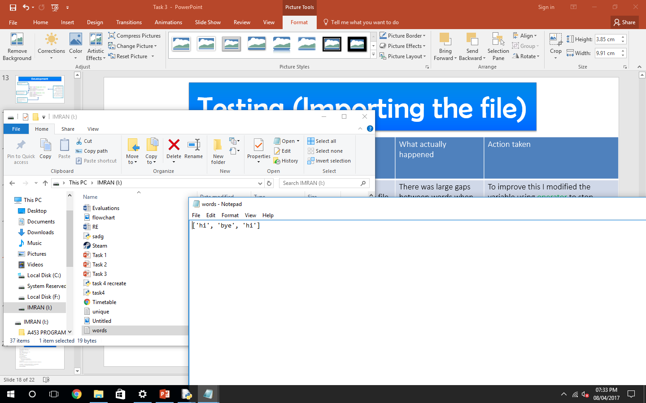
Development (Importing The File)
Area to be tested | How to test this area | What should happen | What actually happened | Action taken
I am testing if the program can create a variable that has been created from a separate program. | Run the second program in the RTE (Run-time-Environment). I will then add a line of code that prints out what is in the variables to see if it has been successfully imported. | The program should import data from the file and put it into a variable. So the program should print out what I wrote in the first program | There was large gaps between words when printed out | To improve this I modified the variable using operator to stop spaces.

Slide 19
Final Code
sentence = input("Enter a sentence: ") #This puts whatever the user inputs into a sentence
sentence = sentence.split() #This splits all words in the sentence to be individually
uniquewords = [] #This is a predefined variable
for word in sentence:
if word not in uniquewords:
uniquewords.append(word)#This puts the unique words into a sentence
print (word)
positions = [uniquewords.index(word)+1 for word in sentence] #Gives the same positions for the same word
file = open("unique.txt", "a+")
file = open("unique.txt", "r+")
file.truncate()
file.write(str(uniquewords))
file.close()#This puts the unique words into a file
file2 = open("words.txt", "a+")
file2 = open("words.txt", "r+")
file2.truncate()
file2.write(str(sentence))
file2.close() #This puts the sentence into a file

Slide 20
Final Code (Program 2)
file = open("unique.txt", "r")
uniquewords = file.read()
file.close()
file2 = open("words.txt", "r")
sentence =file2.read()
file2.close()
print (uniquewords)
print (sentence)
for word in sentence:
if word not in uniquewords:
uniquewords.append(word)
print (word)
positions = [uniquewords.index(word) for word in sentence]
recreated = ''.join([uniquewords[i] for i in positions])
print ("sentence recreate from positions: " )
print (recreated)

Slide 21
Evaluation
Task 3 of the controlled assessments I was task on uncompressing the file I have created. This means that after I compress the file and then using these positions I will recreate the sentence into positons.
In my success criteria it states that the program should work successfully without no logical or syntax errors. My program works correctly even when a large amount of words have been inputted, the program works correctly. This was quite easy as the errors I got when developing the program were nothing major and could be fixed by looking through the code.
The program does identify the words separately. This was easy as it only required the “.split” function to be inputted into the system.
The program also stores variables into a array, this was simple as I have done this in a previous task. For this task I also needed to open the file in a separate program and then convert it back to a variable. This used the same technique so all I needed to do was manipulate the code.
The program should give the same positions to the same words and stores that as an array. This was the main focus of the previous tasks so all I needed to do was use the same technique but this time I also allowed punctuation and capitalisation so it recognises the them as different words as the task asked me to.
The program should save a file with the array variable inside. I have exceeded success criteria in this area as it save the file with all the content inside while also saving the words inputted in the sentence. This was fairly simple as all I needed to do is create a file and store the variable inside.

Slide 22
Glossary
Variable - Something that stores information or data which can be modified
Operators - Used to change variables in the program
Inputs – What the user enters into the program
Outputs – What the computer presents from processing the inputs
Assignments – Another form of an operator which change variables
Sequence – A array stored in a variable in the program
Conditional – An if statement basing the out come from what is given
Iteration– Allow you to update variables in the program
Loops – When the program starts again after ending
Count Loops – When the program loops a certain amount of times
Boolean – Used in an if statement, these are operators basing things on actions e.g. and, or, not
String – Something that contains numbers like a variable
Arrays – A list in a variable
Logical Error – An error in which the program does not work as it was design but does not crash
Syntax Error – An error when there is faults in the code not letting the program run

